Slide 1
CAD/CAM & 3-Axis CNC Machining Simulation Using MasterCAM Introduction and Assignments
MEEG 301-18s

Slide 2
Introductions
Jeff Rickets, Master Machinist (CAM/CAM Assignments, Design Project Prototyping)
Office: 103 SPL
Office Hours: TBD
MasterCAM Help

Slide 3
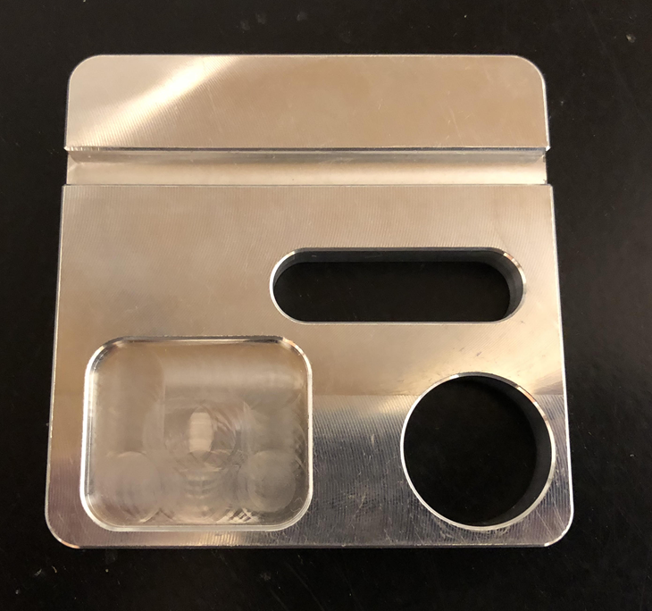
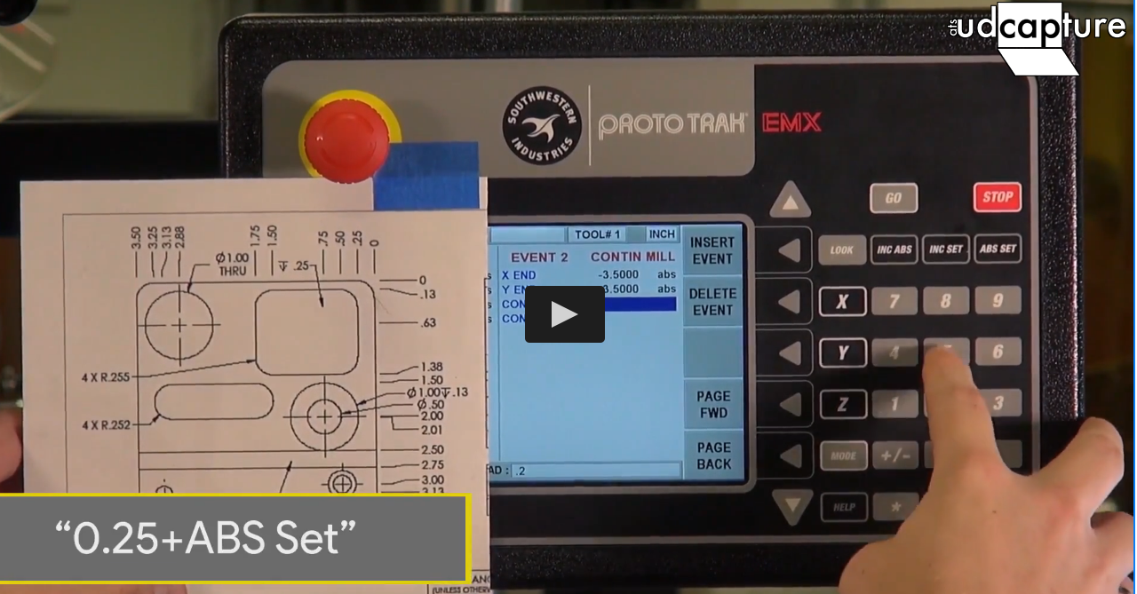
Methods of Machining at UD
How could you make this part?
Manual milling
MEEG 202
X, Y, Z feeds manually operated
CNC 2-axis milling (ProtoTRAK)
MEEG 301 Plate Assignment
X, Y – Computer Numerical Control, Conversational Programming at the Mill
Z – Manually operated
CNC 3-axis milling (MAZAK)
MEEG 301 CAM Assignment
X, Y, and Z CNC Controlled
Manually or Conversationally Programmed
Use Computer-Aided Manufacturing (CAM) Software to generate the Program to control the Mill
Plate from MEEG 301 last semester
2-axis Conversational Programming
from last semester

Slide 4
Videos of 3-Axis MAZAK Milling the MEEG 301 Plate
https://udcapture.udel.edu/misc/engr/engr_shop/
(Video titles that begin with “MazakCNC”)

Slide 5
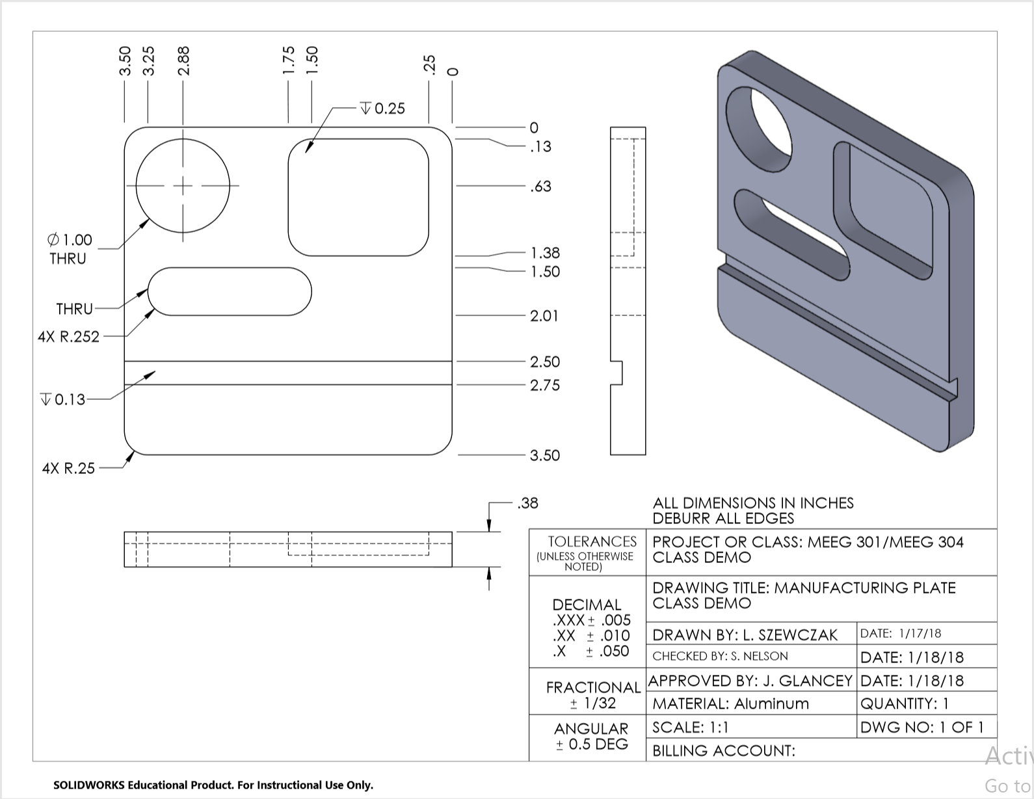
Drawing

Slide 6
How CNC Machines run
CNC - Computer Numerical Control
Formatted number codes tell the machine to move in a desired way and perform certain operations.
What form are the codes and numbers in?

Slide 7
G-Code
Programming language that encodes the instructions that tell CNC machines how and where to move
We use G codes for most functions
We use M codes for miscellaneous functions

Slide 8

Most Common Codes
G00: Rapid tool move
(Above the work surface for positioning-not removing material)
G01: Straight move
(Below the work surface of the part-removing material)
G02: Clockwise arc move
(Below the work surface of the part-removing material)
G03: Counter-clockwise arc move
(Below the work surface of the part-removing material)

Slide 9
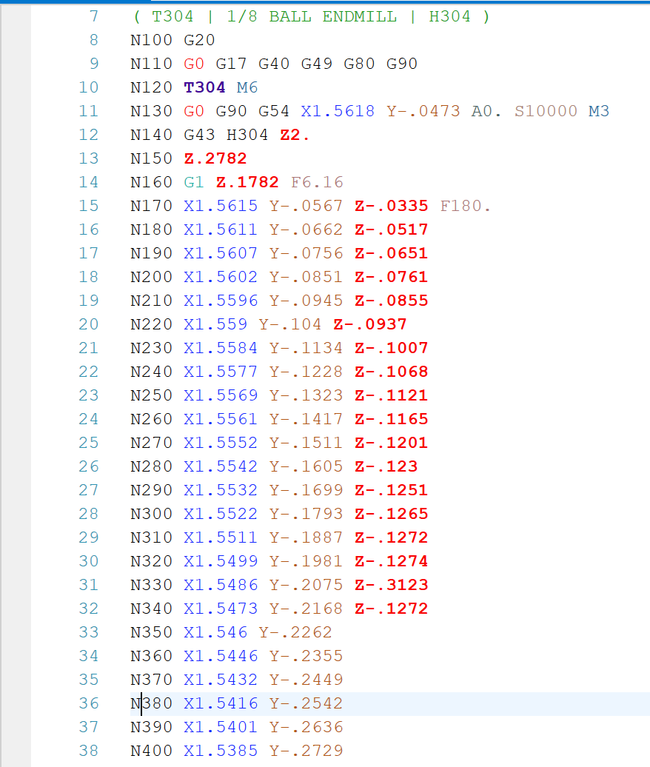
What does G-Code Look Like?
A single line or command is called a code. (Either a G-Code or an M-Code)
An entire file of G-Code would be considered a program. (This program could be sent to a machine)

Slide 10
G-Code Homework Assignment
As a part of Homework #2, you will need to write a portion of a G-Code program.
You will be given an existing G-Code program that you must modify.

Slide 11
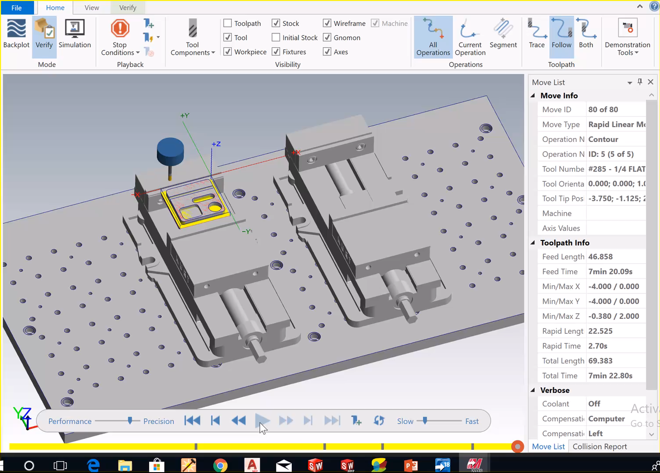
Simulation of Plate Tool Path in MasterCAM

Slide 12
G-Code programs can be long
G-code files can be thousands of lines of code for complex parts and/or 3D surfaces.
This makes them very time consuming to program by hand or conversationally.
There is special software to help automate the process of writing G-Code directly from a CAD file.
Notes:
Jeff

Slide 13
CAM Software
CAM - Computer Aided Manufacturing
Special Software designed to generate the G-Code that runs CNC machines.
Many commercially available software packages
Usually need to start from the solid model rather than just a drawing.
The CAM software we use is MasterCAMTM.
103 SPL or AppsAnywhere.
VPN Needed Off-Campus Access

Slide 14
Video of MasterCAM Simulation

Slide 15
What can MasterCAM do?
MasterCAM can generate programs for 5+ axis CNC machines.
MasterCAM will run simulated machine toolpaths.
Toolpath to create required geometry.
Toolpath to avoid fixturing like vices, clamps, and fasteners etc.
We will use MasterCAM to generate the G-Code program that would control the MAZAK 3-axis mill.

Slide 16
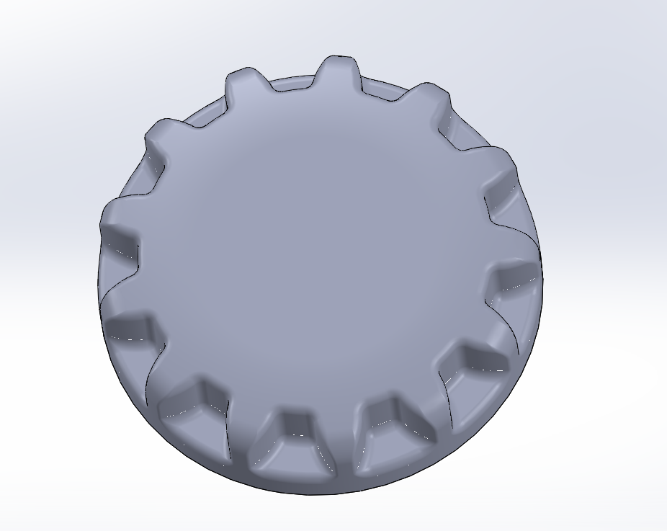
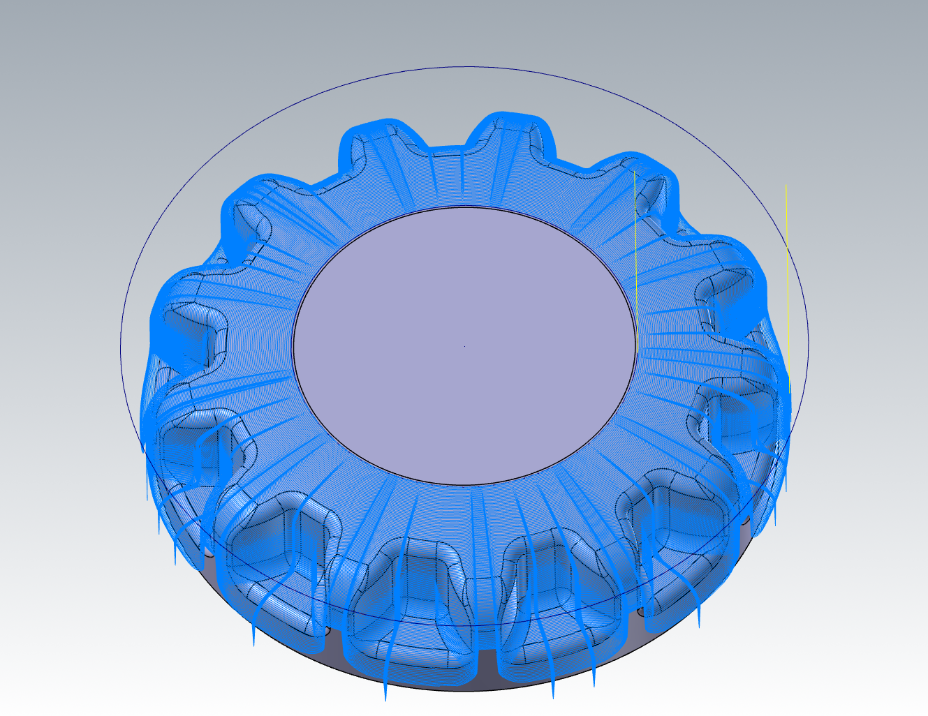
MasterCAM: An Example
SolidWorks Part
G-Code generated from MasterCAM
MasterCAM toolpath
The complete file has 192,787 lines of code

Slide 17
Purpose of MasterCAM
MasterCAM saves you from manually writing thousands of lines of code, but you still have to tell it what to do.
MasterCAM automates the process of writing G-Code, but require detailed information to generate the correct G-Code.

Slide 18
CAD/CAM Assignment MEEG 301
You will use MasterCAM to program your plate with 3D toolpaths.
More details about the assignment will be released next week.

Slide 19
Questions?

